Slide 1
A Generative Adversarial Network with Manual Hyperparameter Tuning for the Fashion-MNIST dataset
By Vani Kanoria

Slide 2
Outline
Introduction to Generative Adversarial Networks
Dataset and My Goal
My Implementation
Results
Hyperparameter Optimization
Results: Hyperparameter Optimization

Slide 3
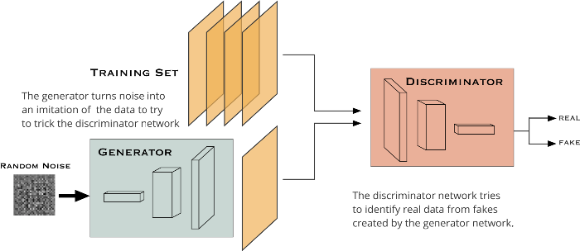
Generative Adversarial Networks (GAN’s)
Notes:
I use Generative Adversarial Networks to generate images in my model.
In an ordinary GAN structure, there are two agents competing with each other: a Generator and a Discriminator. They may be designed using different networks since I will be working with images, Convolutional Neural Networks are better suited for the task.

Slide 4
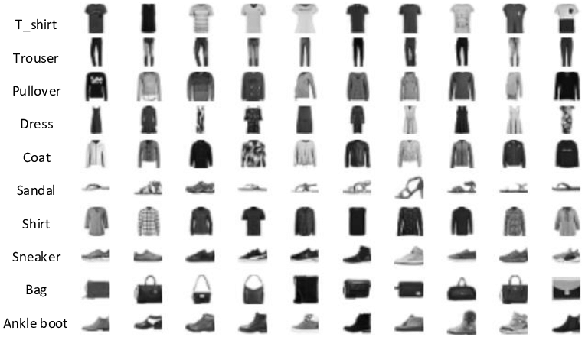
Dataset and my Goal
Fashion MNIST
28×28 grayscale images of 70,000 fashion products
Goal: Generate fashion images using the generator and discriminator combination and use feedback loop during training to improve upon images generated
Utilized tutorial: https://towardsdatascience.com/image-generation-in-10-minutes-with-generative-adversarial-networks-c2afc56bfa3b
Notes:
I use Fashion-MNIST data to train a model that generates fashion images from random noise, uses a discriminator to predict which of the images are fake, and uses the feedback loop during training to improve upon the images generated.

Slide 5
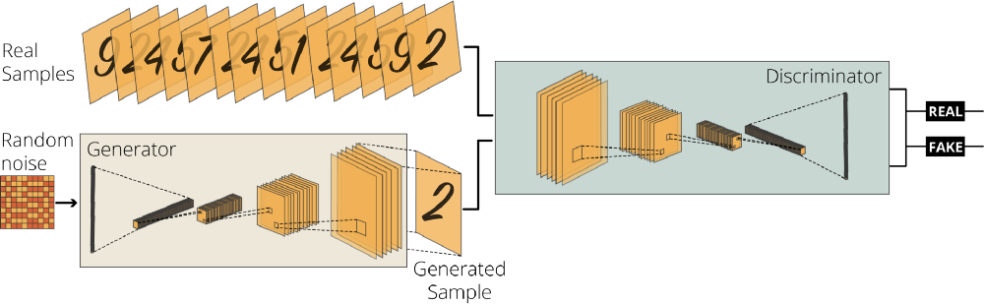
My implementation
Generator Network: generates 28x28 pixels grayscale fake images from random noise
Discriminator Network
2 loss functions: cross entropy
2 optimizers: Adam
Notes:
Generate a generator network (with Keras Sequential API) that generates 28x28 pixels grayscale fake images from random noise. Layers used in generator network: BatchNormalization, LeakyRelu and Conv2DTranspose layers.
Generate a discriminator network by following the inverse version of the generator network. Layers used in discriminator network: Conv2D, LeakyReLU, Dropout and Flatten layer
The discriminator network takes the 28x28 pixels image data and outputs and its output is a single floating number representing the possibility of authenticity. Positive and negative values signify a real and fake image respectively.

Slide 6
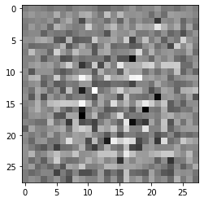
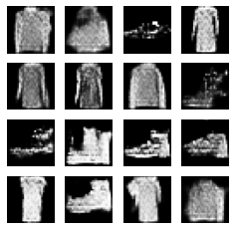
Results
2 Conv2D layers: 128 and 64 neurons respectively, dropout rate = 0.3, 60 epochs,

Slide 7
Evolution of GAN Model: Epoch 1 —-> Epoch 60
Notes:
These images are not only outputs in each epoch, but also represent the evolution of the GAN model, consisting of the generator and the discriminator

Slide 8
Hyperparameter optimization
Manual
Why it is hard to use other methods
Both the generator model and the discriminator model are trained simultaneously in a game. This means that improvements to one model come at the expense of the other model.
Algorithms exist for specialized cases, but we are not aware of any that are feasible to apply to the GAN game, where the cost functions are non-convex, the parameters are continuous, and the parameter space is extremely high-dimensional
Notes:
Both the generator model and the discriminator model are trained simultaneously in a game. This means that improvements to one model come at the expense of the other model.
Similar to finding a Nash equilibrium to a two-player non-cooperative game. […] Unfortunately, finding Nash equilibria is a very difficult problem. Algorithms exist for specialized cases, but we are not aware of any that are feasible to apply to the GAN game, where the cost functions are non-convex, the parameters are continuous, and the parameter space is extremely high-dimensional
The goal of training two models involves finding a point of equilibrium between the two competing concerns.
But with a GAN, every step taken down the hill changes the entire landscape a little. It’s a dynamic system where the optimization process is seeking not a minimum, but an equilibrium between two forces.

Slide 9
Dropout layers
Learning only a fraction of weights in the network in each iteration by randomly setting input units to zero with a frequency of rate at each step
Resolves the overfitting issue in large networks
Notes:
The Dropout layer randomly sets input units to 0 with a frequency of rate at each step during training time, which helps prevent overfitting. Inputs not set to 0 are scaled up by 1/(1 - rate) such that the sum over all inputs is unchanged
Note that the Dropout layer only applies when training is set to True such that no values are dropped during inference. When using model.fit, training will be appropriately set to True automatically, and in other contexts, you can set the kwarg explicitly to True when calling the layer.

Slide 10
Results: Hyperparameter tuning

Slide 11
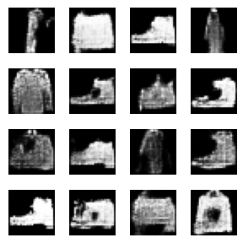
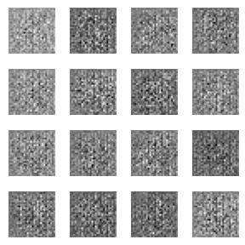
Parameter 1: Number of neurons: 128
Parameter 2:
Dropout rate = 0.1:
Dropout rate = 0.3:
Dropout rate = 0.5:

Slide 12
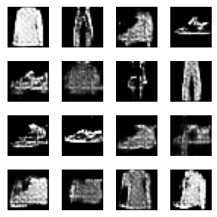
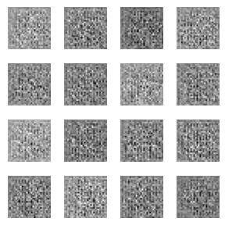
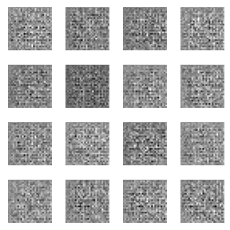
Parameter 1: Number of neurons: 64
Parameter 2:
Dropout rate = 0.1:
Dropout rate = 0.3:
Dropout rate = 0.5:

Slide 13
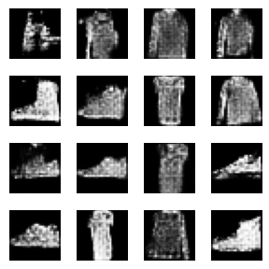
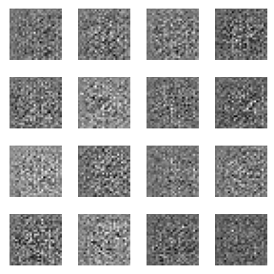
Parameter 1: Number of neurons: 256
Parameter 2:
Dropout rate = 0.1:
Dropout rate = 0.3:

Slide 14
Evaluation
 |  | No. of neurons in layer 1 | 128 | 128 | 128 | 64 | 64 | 64 | 256 | 256
Row no. | Column no. | dropout rate | 0.1 | 0.3 | 0.5 | 0.1 | 0.3 | 0.5 | 0.1 | 0.3
1 | 1 | Scores | 5 | 8 | 1 | 5 | 1 | 1 | 2 | 1
1 | 2 |  | 6 | 5 | 1 | 6 | 1 | 1 | 5 | 1
1 | 3 |  | 8 | 7 | 1 | 4 | 1 | 1 | 6 | 1
1 | 4 |  | 4 | 8 | 1 | 8 | 1 | 1 | 5 | 1
2 | 1 |  | 8 | 7 | 1 | 7 | 1 | 1 | 4 | 1
2 | 2 |  | 2 | 8 | 1 | 3 | 1 | 1 | 4 | 1
2 | 3 |  | 1 | 7 | 1 | 4 | 1 | 1 | 5 | 1
2 | 4 |  | 6 | 6 | 1 | 6 | 1 | 1 | 7 | 1
3 | 1 |  | 4 | 5 | 1 | 6 | 1 | 1 | 4 | 1
3 | 2 |  | 5 | 2 | 1 | 8 | 1 | 1 | 5 | 1
3 | 3 |  | 4 | 9 | 1 | 5 | 1 | 1 | 3 | 1
3 | 4 |  | 3 | 3 | 1 | 3 | 1 | 1 | 6 | 1
4 | 1 |  | 7 | 4 | 1 | 3 | 1 | 1 | 4 | 1
4 | 2 |  | 3 | 4 | 1 | 2 | 1 | 1 | 4 | 1
4 | 3 |  | 3 | 2 | 1 | 6 | 1 | 1 | 5 | 1
4 | 4 |  | 8 | 5 | 1 | 4 | 1 | 1 | 5 | 1
 |  | Mean score | 4.8125 | 5.625 | 1 | 5 | 1 | 1 | 4.625 | 1
Self-evaluation
Scores between 1 and 10

Slide 15
Sources
https://towardsdatascience.com/image-generation-in-10-minutes-with-generative-adversarial-networks-c2afc56bfa3b
https://www.analyticsvidhya.com/blog/2020/02/cnn-vs-rnn-vs-mlp-analyzing-3-types-of-neural-networks-in-deep-learning/

